Slide 1
Opening a pub in Central London
Anitya Vilekar

Slide 2
Location selection is key for pubs -
In a city like London, which is full of footballs fans who are frequenters in pubs, it is necessary to choose the appropriate location
Factors such as population, public transport access, presence of competition play a major role
Due to a large number of pre-existing pubs, location selection can be complicated

Slide 3
Data Acquisition and Cleaning –
Data pertaining to public transport access points in London was obtained from the government database (data.gov.uk)
FourSquare API was used to obtain venues within 500m of the points in the public transport database
The results were then filtered, and a database of pubs and their location was created that was subsequently used for visualization and analysis

Slide 4
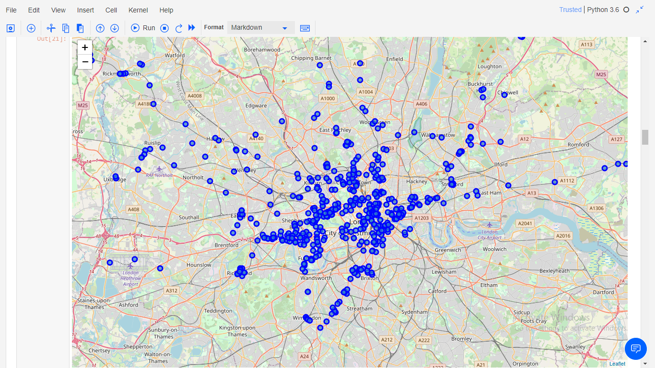
Map highlighting pubs in London near public transport access points

Slide 5
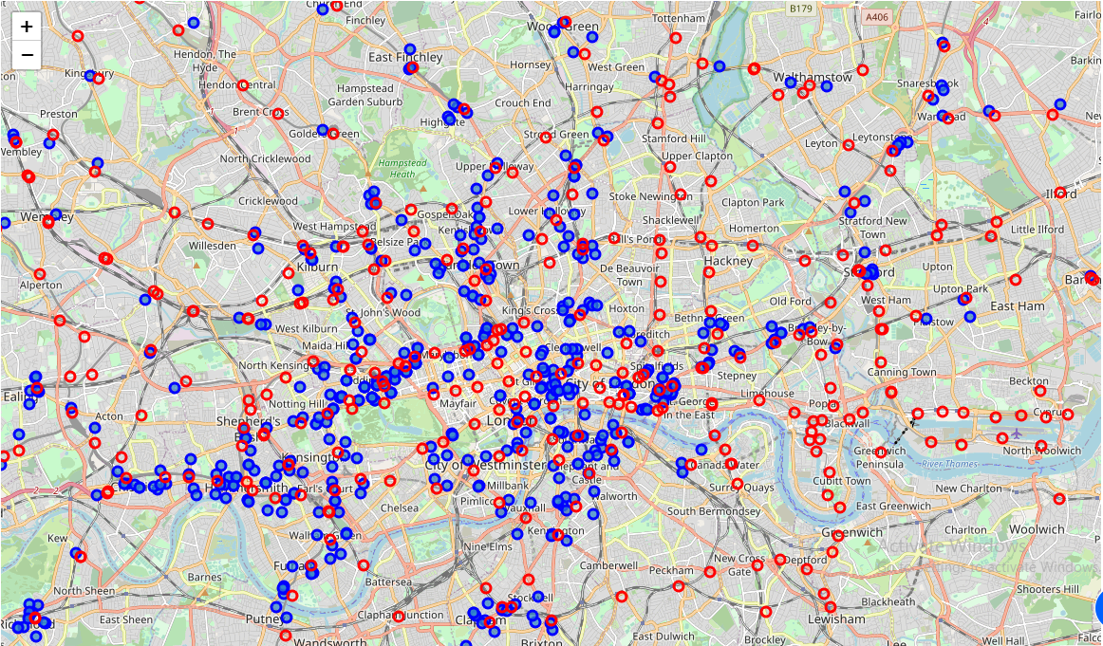
The public transport points superimposed on the pub locations

Slide 6
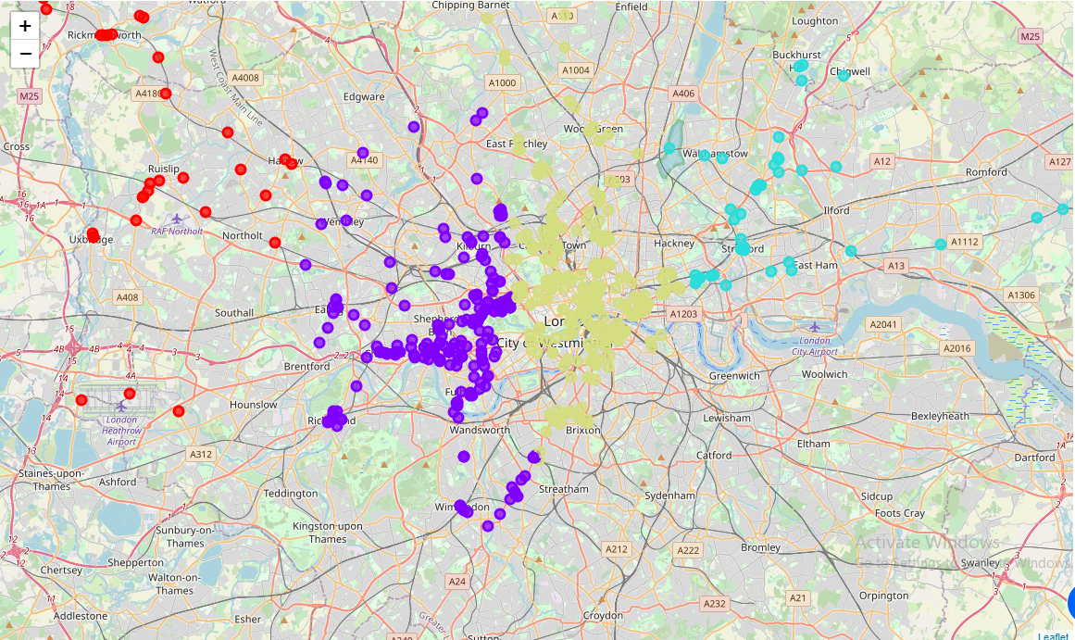
Map highlighting pubs clustered into 4 groups

Slide 7
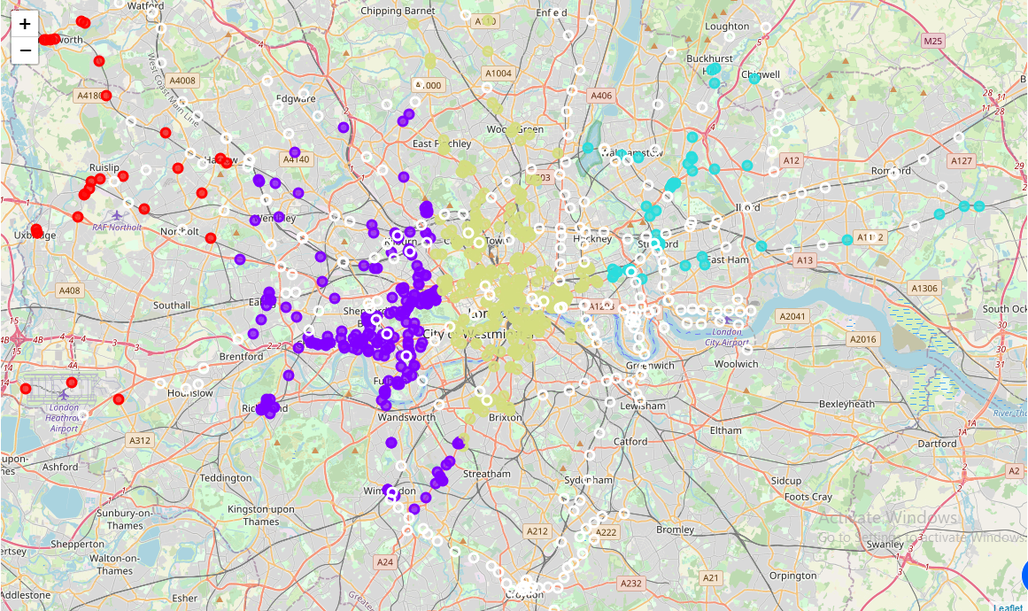
Public transport points with no pubs within 500m, superimposed on pub clusters

Slide 8
Conclusion -
By exploring the dataset and the visualizations, it was concluded that Chelsea, Hackney, and Mayfair are suitable areas to open a new pub
These locations have lower densities of pubs, higher population and footfall due to presence in city center, and easy access to public transport

